Slide 1
MULTI-CUT-OFF REBAR
Advisor : Prof. K.C.Chang
Presenters : You-Ran Nai
Notes:
Try 講清楚脈絡

Slide 2
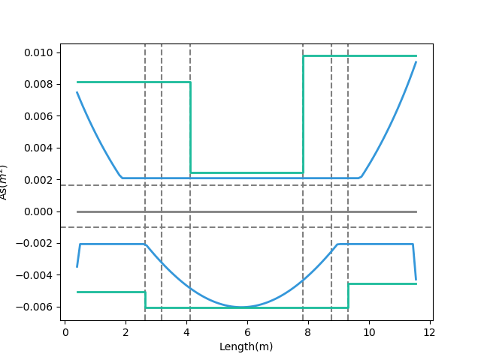
Max
Max
Design As
Today’s Solution
Fixed Bar-Cut
Max
Demand As
Notes:
LowSeismic4Floor12M 0

Slide 3
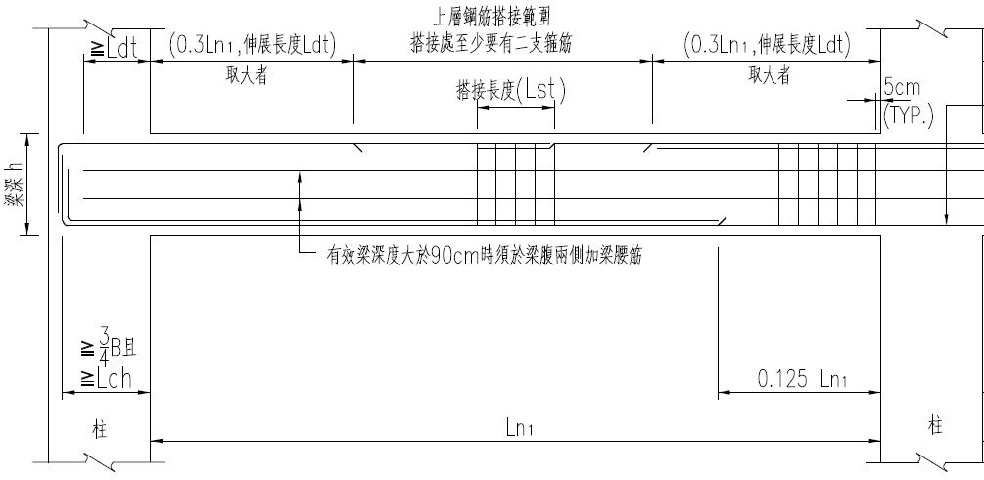
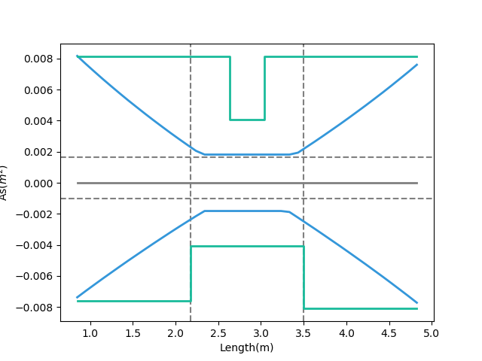
大梁鋼筋配置標準圖
Tradition
Design As
Demand As
Notes:
欣銓 1140

Slide 4
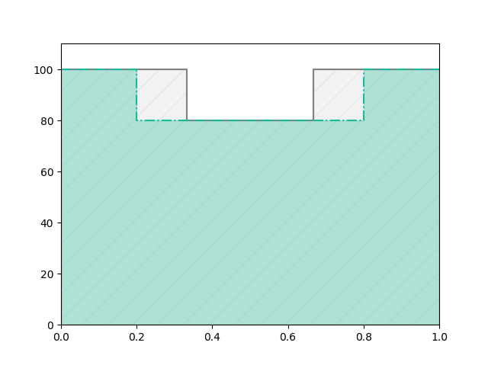
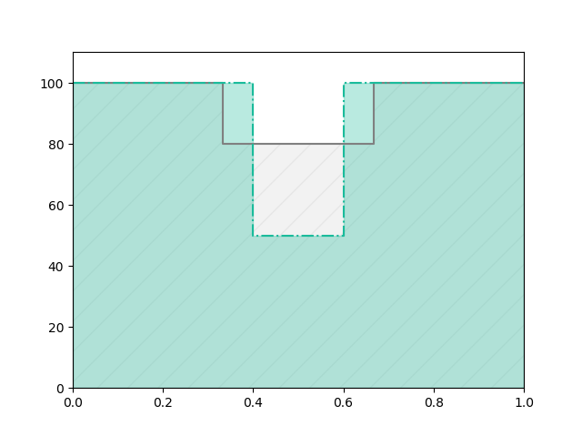
Before
After
REDUCE REBAR
Before
Real
Demand
After

Slide 5
Outline
Part 2
Part 4
Shear Reinforcement
Nonlinear Verification
Part 1
Part 3
Flexural Reinforcement
Condition

Slide 6
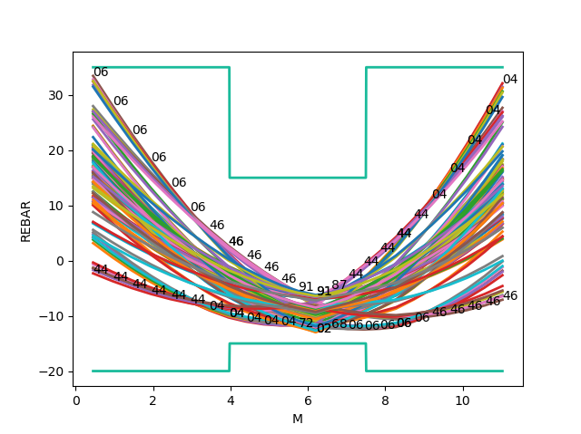
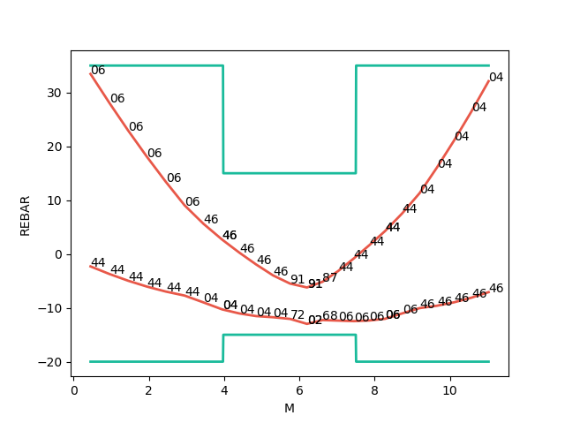
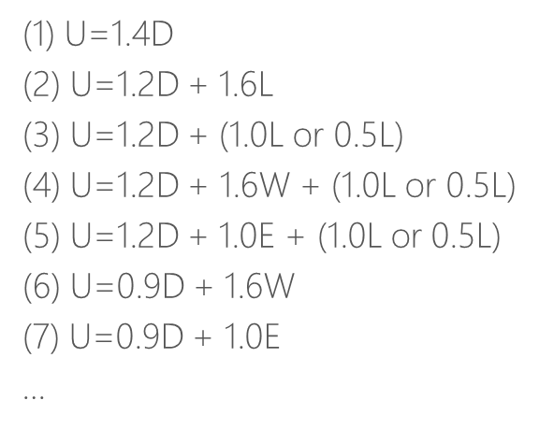
Mu
Consider Hundreds Of Combo Demand
Catch Critical Demand Combo

Slide 7
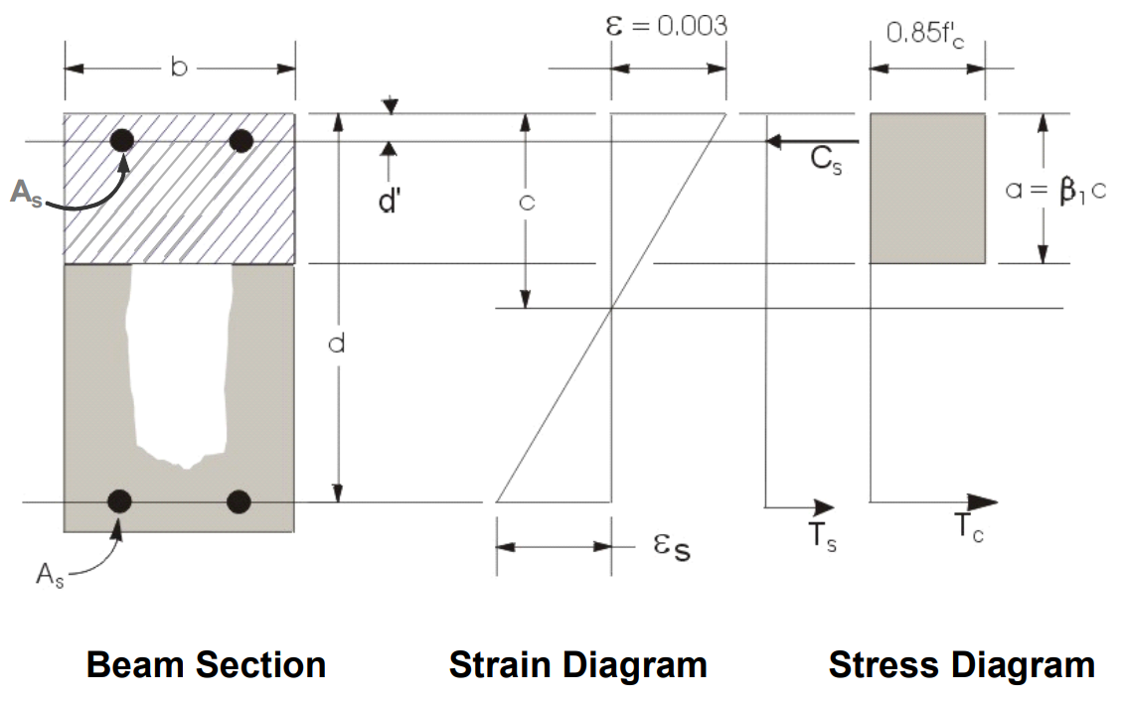
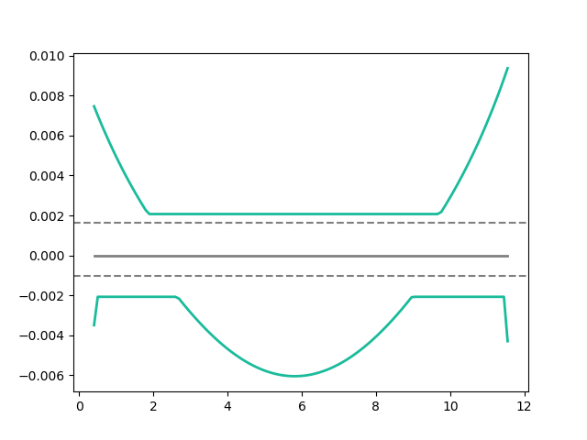
Flexural Reinforcement
Area of flexural reinforcement
Min: 2 Rebar

Slide 8
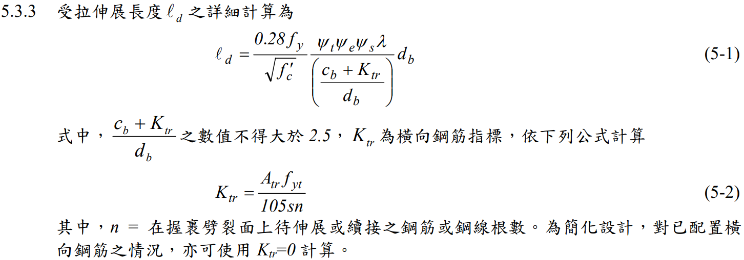
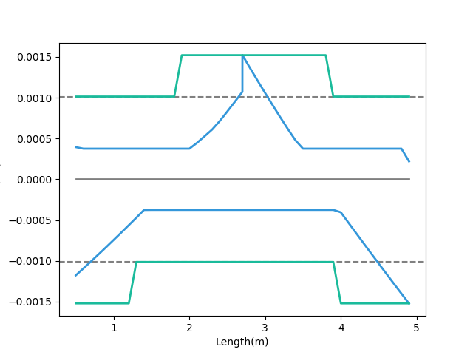
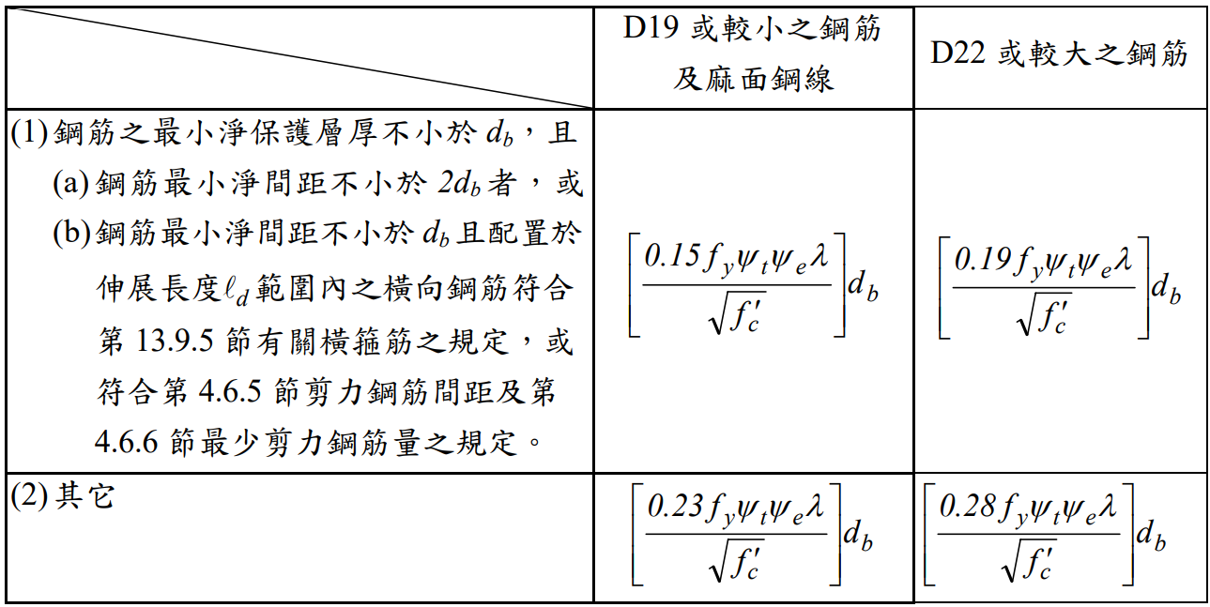
General Development Length Equation
Development Length
Demand As
MIN
Simplified Provisions
Add Ld As
Notes:
欣銓 1228

Slide 9
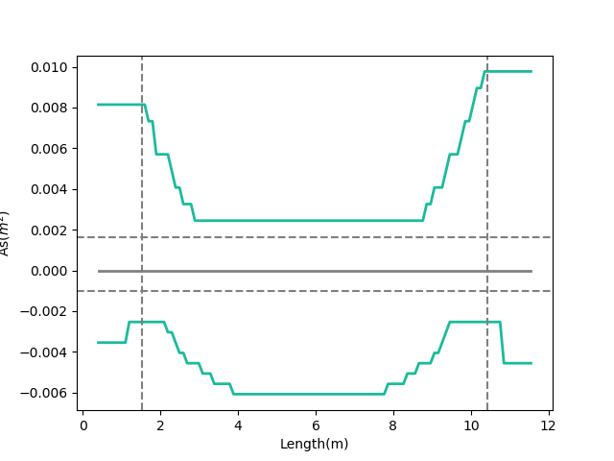
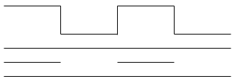
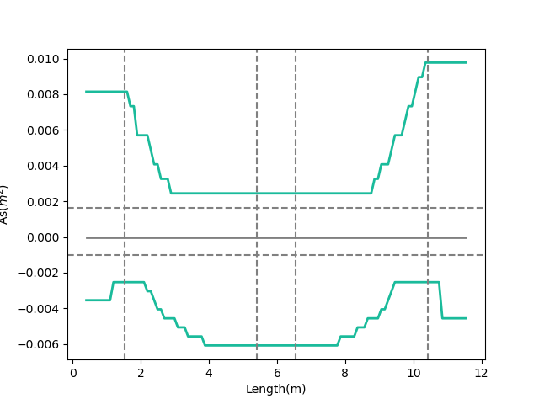
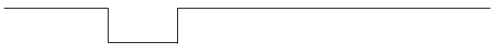
Combinations
As
多點
0.1
0.9
漸進式退縮
三段
0.1
0.45
0.55
0.9
Notes:
GA 演算法
LowSeismic 4Floor 12M 0

Slide 10
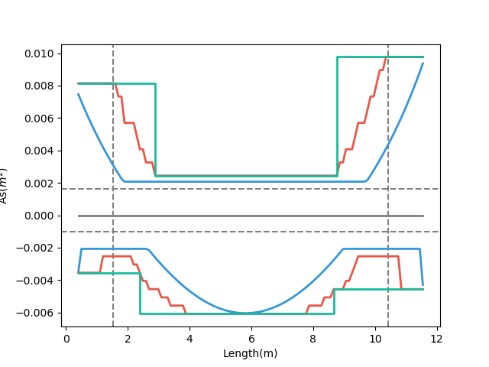
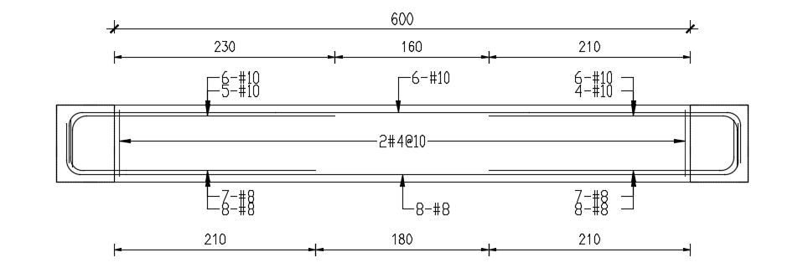
Development Length
梁撓曲鋼筋配置示意圖
Design As
Demand As
Notes:
LowSeismic 4Floor 12M 0

Slide 11
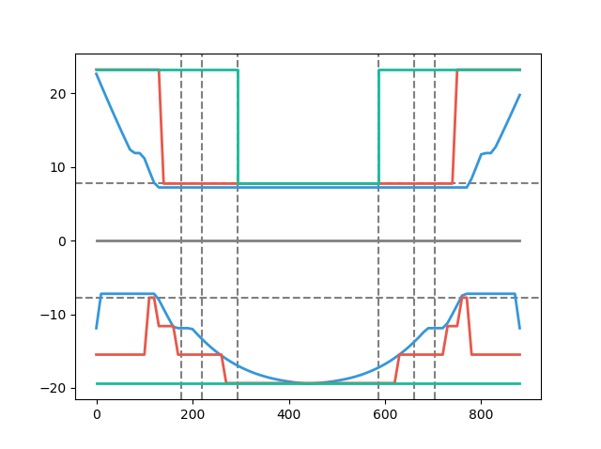
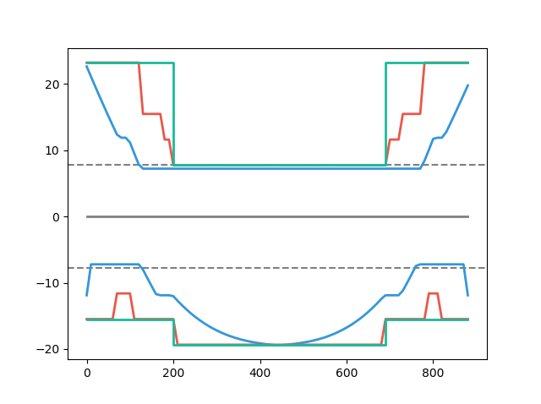
Simple Conclusion
Tradition
Simplified Ld
Multi-Cut
Design As
Design As
Explicit Ld
100%
80%
As(cm2)
Demand As
Demand As
100%
91%
Length(cm)
Length(cm)
Notes:
高雄物流中心 11076

Slide 12
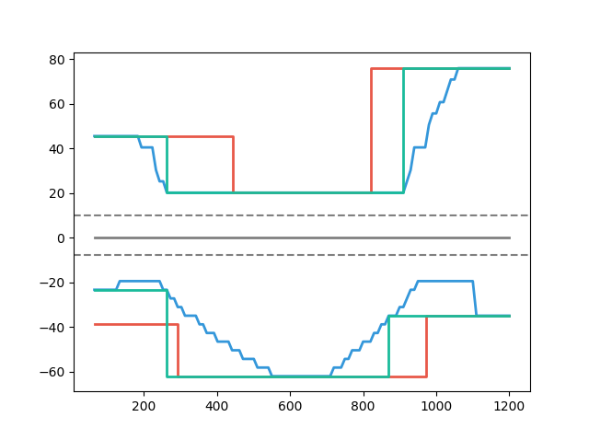
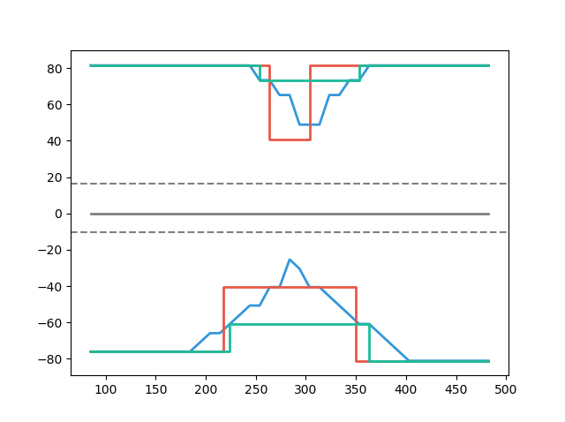
Case Study
Multi-Cut 82%
Tradition
Multi-Cut
Tradition
Development Length
Development Length
Multi-Cut 91%
Length(cm)
Notes:
傳統不經濟
828
傳統不保守 不符合 混凝土結構設計規範 401-100 R5.11.2
1140

Slide 13
Outline
Part 2
Part 4
Shear Reinforcement
Nonlinear Verification
Part 1
Part 3
Flexural Reinforcement
Condition

Slide 14


Slide 15
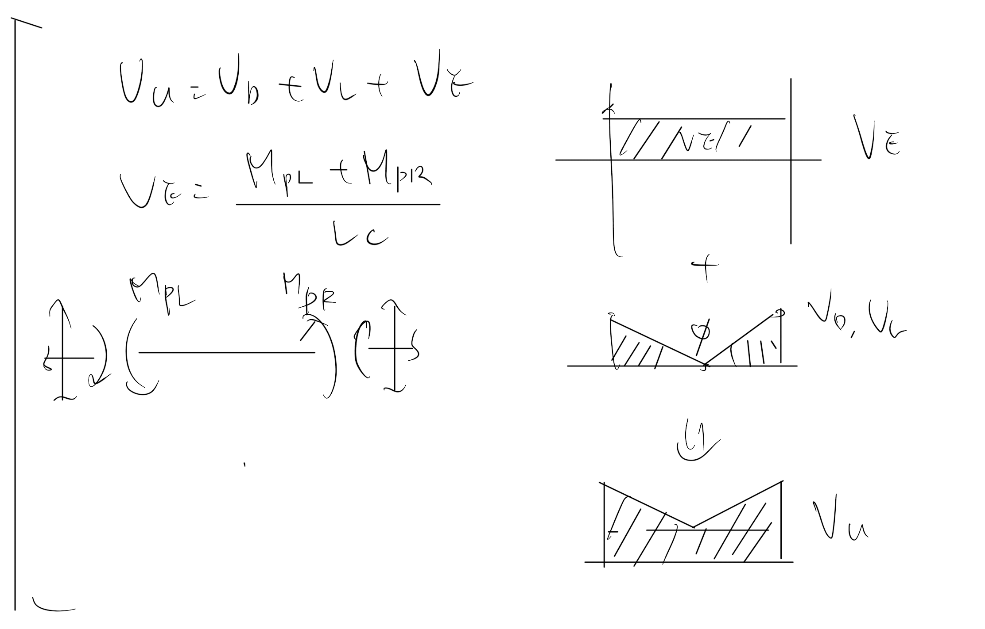
Vu
Notes:
LowSeismic4Floor12M 0

Slide 16
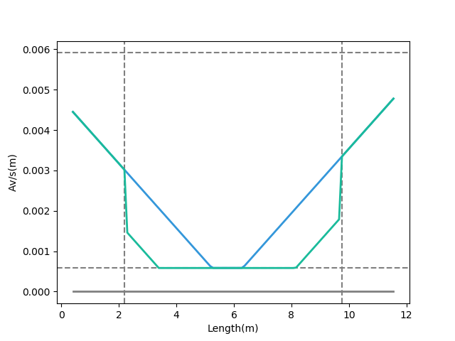
Shear Reinforcement
Vu
Notes:
LowSeismic4Floor12M 0

Slide 17
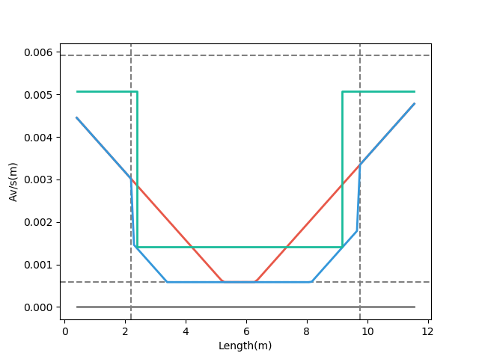
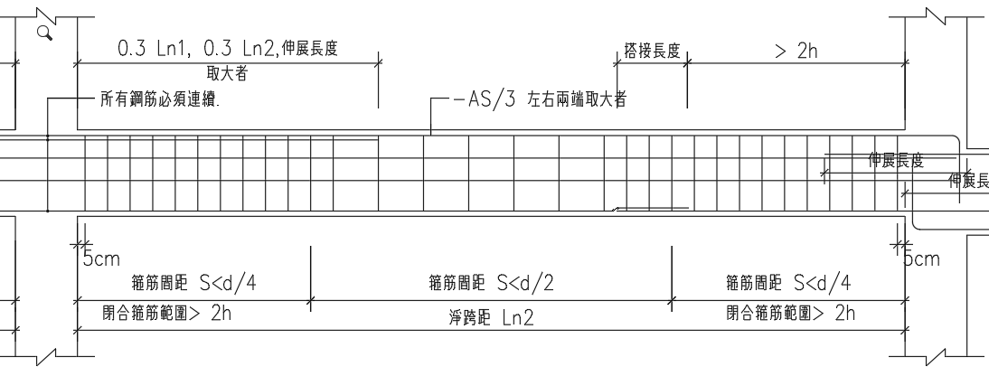
梁剪力鋼筋配置示意圖
Design Av
Demand Av
Consider Vc Demand
Notes:
LowSeismic4Floor12M 0

Slide 18
Outline
Part 2
Part 4
Shear Reinforcement
Nonlinear Verification
Part 1
Part 3
Flexural Reinforcement
Condition

Slide 19
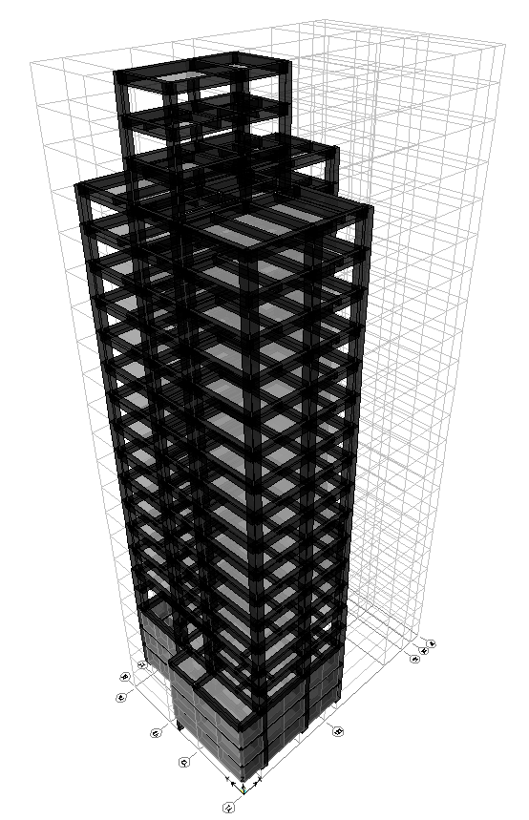
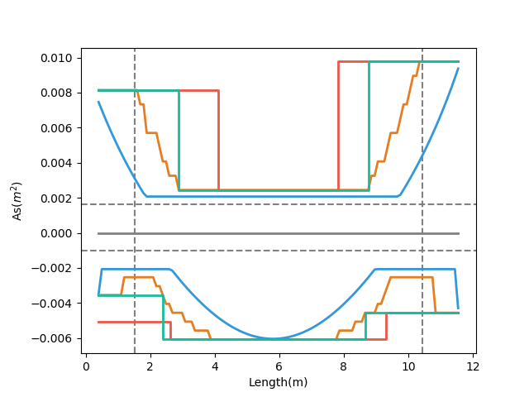
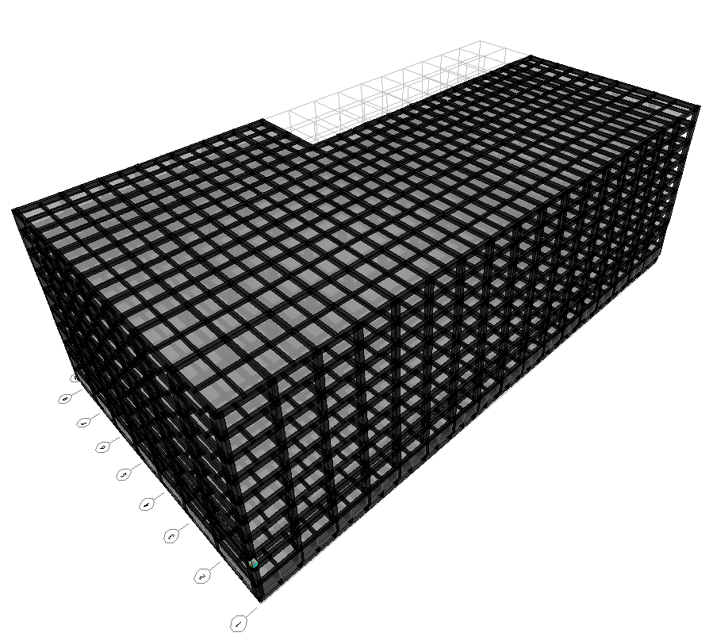
台北住宅案
Multi-Cut As
Development Length
Tradition As
Demand As
高雄物流中心
Notes:
LowSeismic4Floor12M 0

Slide 20
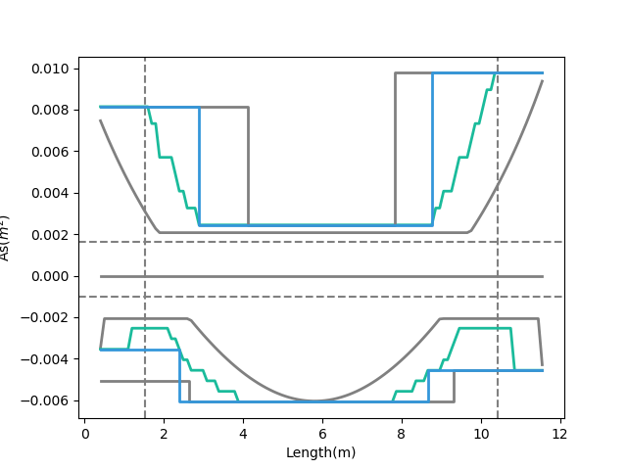
Development Length
Multi-Cut As
Short Development Length
Tradition As
Beam Length
Demand As
Notes:
LowSeismic4Floor12M 0

Slide 21
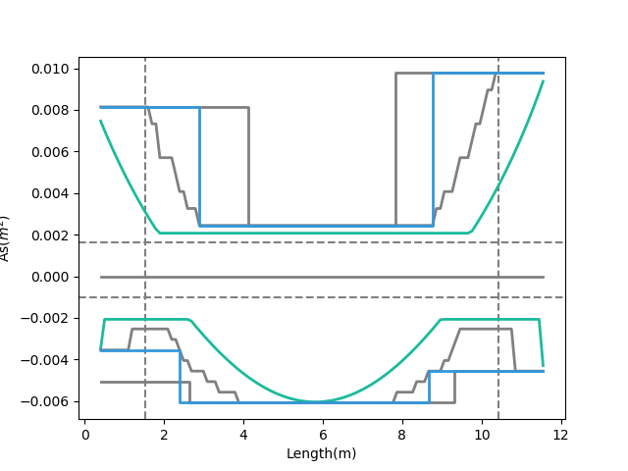
Multi-Cut As
Tradition As
Moment Decay
Demand As
Notes:
LowSeismic4Floor12M 0

Slide 22
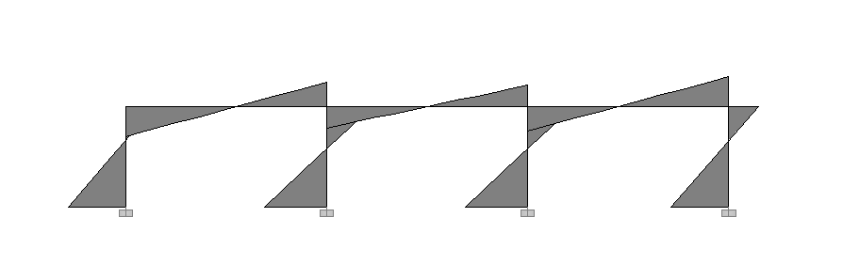
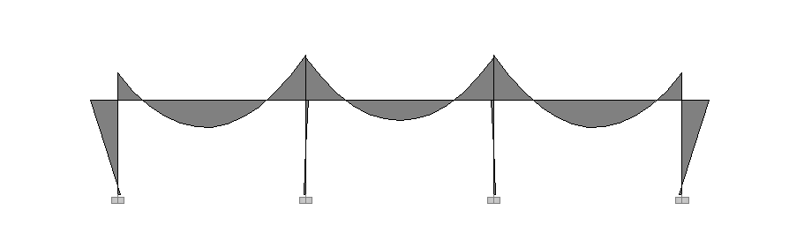
Seismic Load
Lateral
Force
Moment Diagram
Gravity Load
Gravity Load

Slide 23
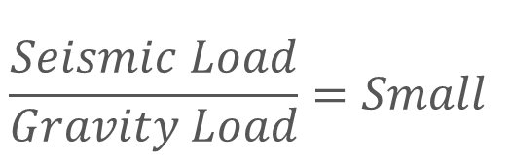
Lateral
Force
Moment Decay
$$\frac{Seismic Load}{Gravity Load}=Small$$
Gravity Load
Beam Length

Slide 24
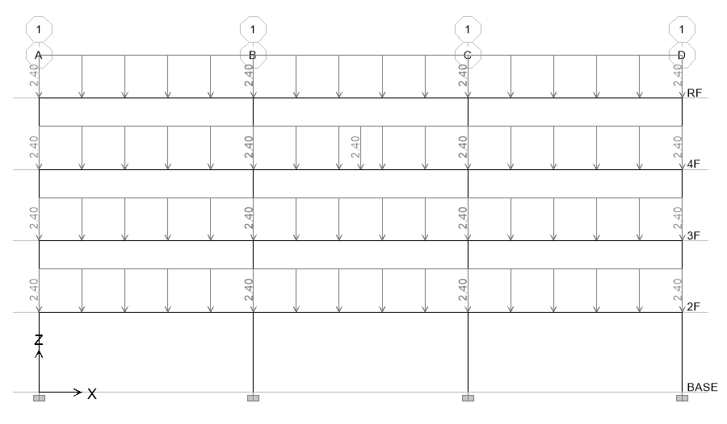
11 Models
Notes:
LowSeismic4Floor12M 0

Slide 25
Evaluation
6m
9m
12m
Low Seismic

Slide 26
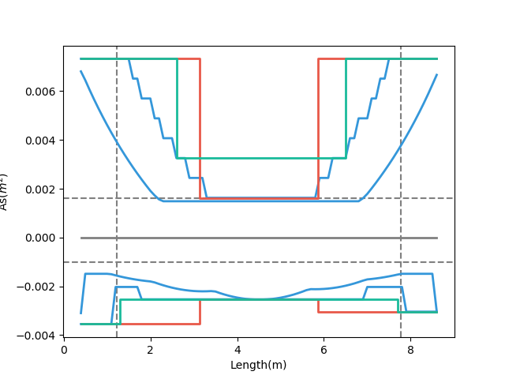
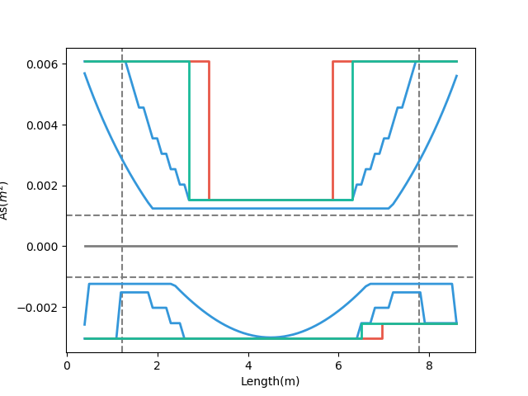
High Seismic
Low Seismic
99%
89%
89%
99%

Slide 27
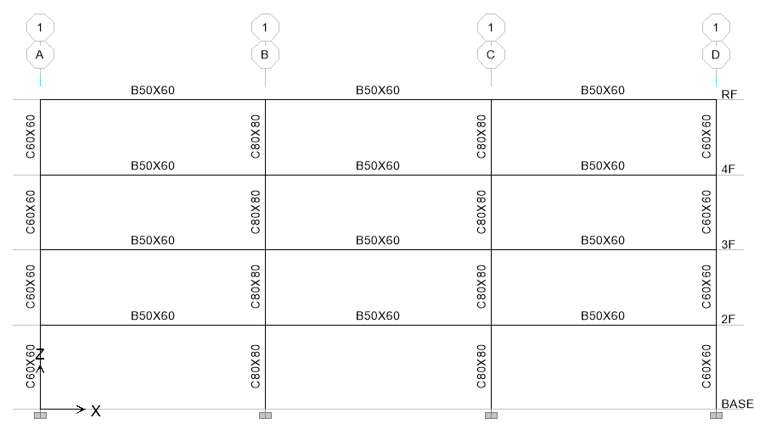
Evaluation
3
47.9s
12 支梁
4
3.9min
5
23.1min
6
2.0hr
Notes:
理論最佳解

Slide 28
台北住宅案
100.1%
OVERALL RESULT
14F B3
101.3%
TOP RESULT
98.5%
BOT RESULT
20m
30m
Notes:
由於很複雜，先記得最終的結果
400

Slide 29
9F B1
93.4%
OVERALL RESULT
92.3%
TOP RESULT
153m
77m
94.7%
BOT RESULT
高雄物流中心
Notes:
3500

Slide 30
Cost Analysis
Reduced Percentage
Material Reduced Cost
$$Δ=−\frac{60kg}{m^{2}}∗2\%∗\frac{\$28}{kg}=−\$33.6/m^{2}$$
Girder Used
Material Cost

Slide 31
Cost Analysis
Increase
Construction Cost
Reduced
Material Cost
$$Δ=\frac{\$100}{t}∗\frac{0.15t}{m^{2}}−\frac{60kg}{m^{2}}∗2\%∗\frac{\$28}{kg}=−\$18.6/m^{2}$$
$$Δ=\frac{\$200}{t}∗\frac{0.15t}{m^{2}}−\frac{60kg}{m^{2}}∗2\%∗\frac{\$28}{kg}=−\$3.6/m^{2}$$
Increase Wage

Slide 32
Cost Analysis
$$Δ=−\frac{60kg}{m^{2}}∗2\%∗\frac{\$28}{kg}=−\$33.6/m^{2}$$
$$Δ=\frac{\$100}{t}∗\frac{0.15t}{m^{2}}−\frac{60kg}{m^{2}}∗2\%∗\frac{\$28}{kg}=−\$18.6/m^{2}$$
$$Δ=\frac{\$200}{t}∗\frac{0.15t}{m^{2}}−\frac{60kg}{m^{2}}∗2\%∗\frac{\$28}{kg}=−\$3.6/m^{2}$$
$$Δ=\frac{\$200}{t}∗\frac{0.15t}{m^{2}}−\frac{60kg}{m^{2}}∗5\%∗\frac{\$28}{kg}=−\$54/m^{2}$$

Slide 33
Outline
Part 2
Part 4
Shear Reinforcement
Nonlinear Verification
Part 1
Part 3
Flexural Reinforcement
Condition

Slide 34
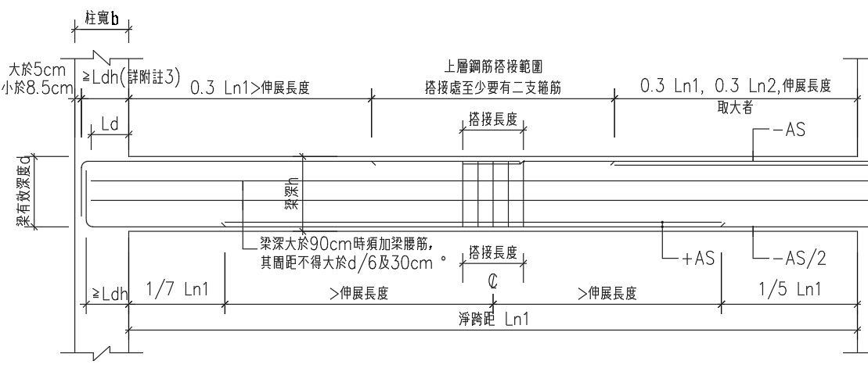
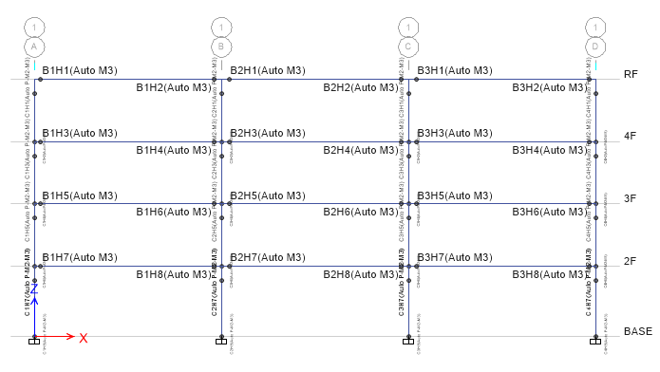
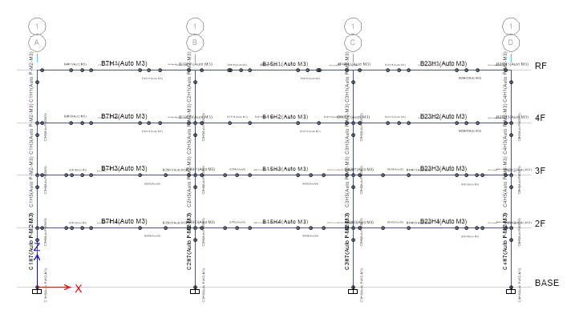
Consider Ld

Slide 35
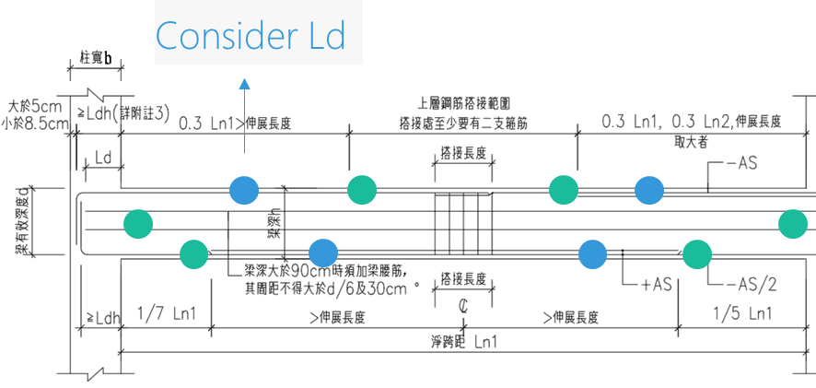
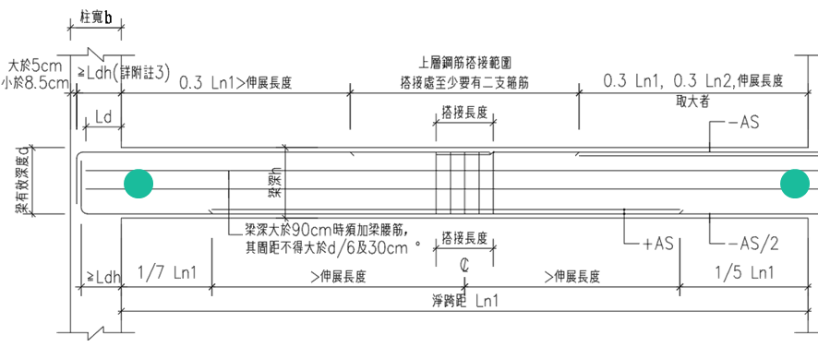
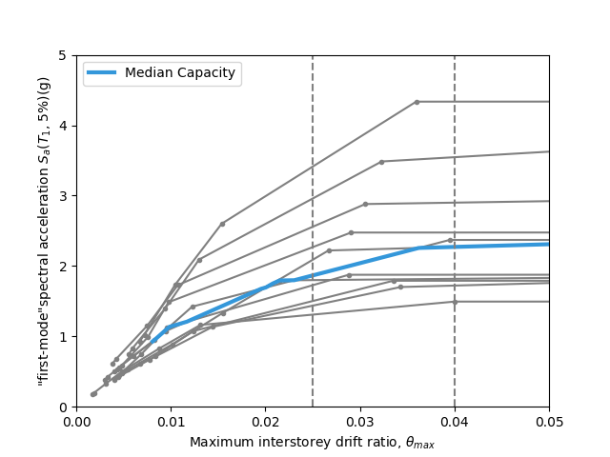
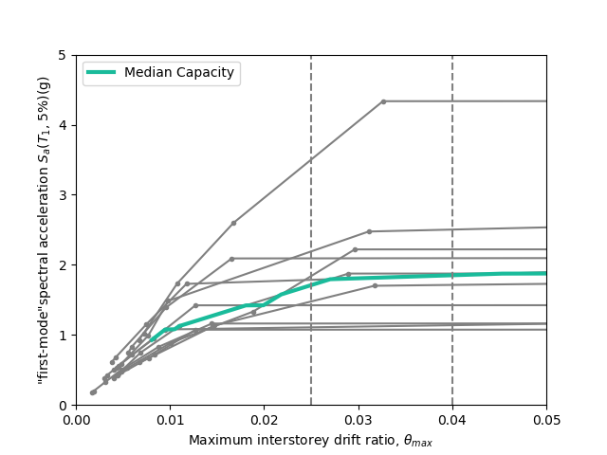

Slide 36
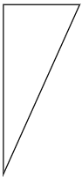
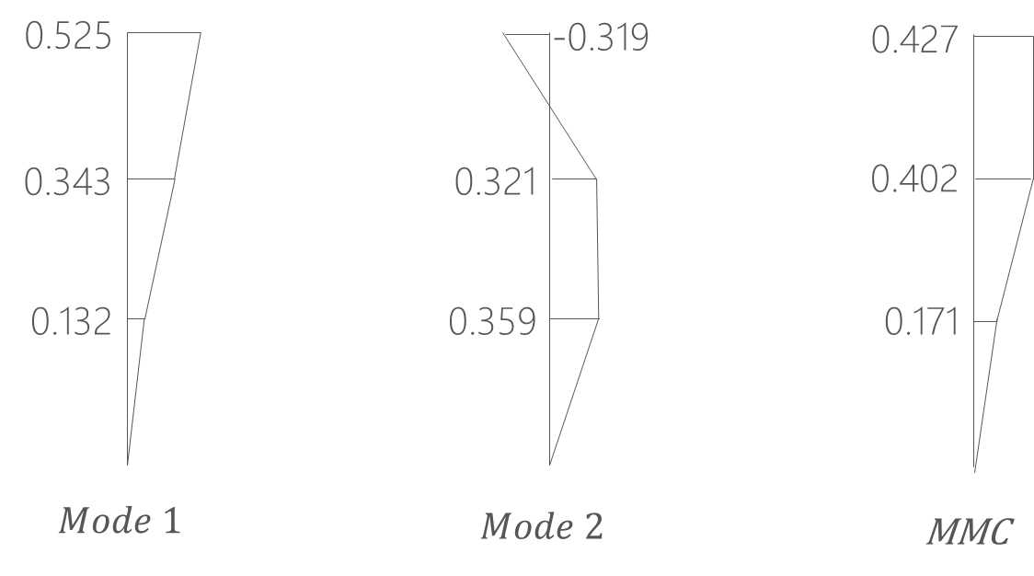
Pushover Load Pattern
Inverted Triangle
Multi-Modes Combination
Modal Pushover Analysis
SRSS
Notes:
定義非線性驗證的邊界

Slide 37
Mid Multi
MMC

Slide 38
Mid Multi

Slide 39
Mid Multi

Slide 40
Inverted Triangle

Slide 41
Multi-Modes Combination

Slide 42
Modal Pushover Analysis

Slide 43
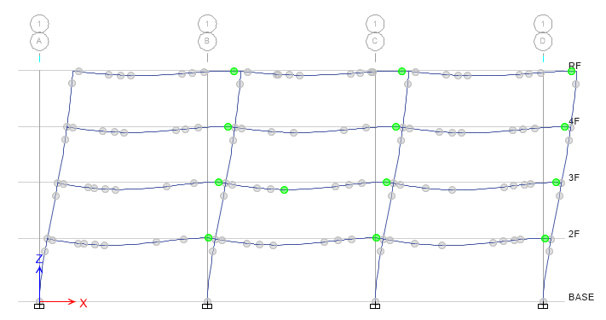
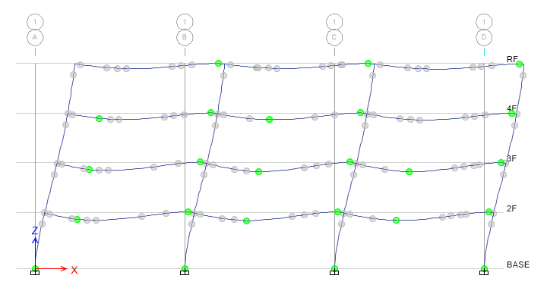


Step 3
Step 5
Step 7
Step 8

Slide 44

Hinge
Third Hinge
+

Slide 45


Hinge
Without Initial Conditions

Slide 46

Time history
Story Drift
Scaled to DBE, MCE
DBE < 1.5%
MCE < 2%

Slide 47
Scaled

Slide 48


DBE
MCE

Slide 49


Multiple Hinges

Slide 50


Incremental Dynamic Analysis
Single Static Analysis
➔
Incremental SPO
Single Time History Analysis
➔
Incremental One

Slide 51

Non-Linear SPO
Elastic
➔
Match
Non-Negative
➔
Equal Displacement
Negative
➔
Softening

Slide 52


Limit-State
4% FEMA273
2.5% SEAOC2000

